Slide 1

SMART INDIA HACKATHON 2026
Problem Statement ID – SIH26157
Problem Statement Title- Supervisory Analytics Tool for SOC Assessment (SAT-SA)
Theme- Miscellaneous
PS Category- Software
Team ID- 074
Team Name- Coder Rise

Slide 2
IDEA DETAILS
Coder
Rise
Supervisory Analytics Tool for SOC Assessment (SAT-SA) is a software-based supervisory analytics platform that analyses SOC operational evidence from Critical Sector Entities (CSEs) to identify operational patterns and weaknesses requiring supervisory attention.
It enables supervisors to analyse alerts, cases, investigations and escalation records, prioritise evidence for manual review, and generate explainable, evidence-backed supervisory findings and reports.
How It Addresses the Problem ?
Periodic CSE Data
↓
Data Ingestion & Validation
↓
Supervisory Analytics
↓
Execution Gaps | Negative Space | Anomalies | Peer Benchmarking
↓
Entity Attention Score
↓
Evidence-backed Prioritisation
↓
Human Supervisory Review
↓
Supervisory Report
Innovation / Uniqueness:
Execution Gap Detection
Negative Space Analysis
Explainable Attention Scoring
Peer Benchmarking
Evidence Traceability
Multi-CSE Comparative Assessment
Evidence-backed Sample Prioritisation
Human-in-the-Loop Assessment
Offline / Air-Gapped Operation

Slide 3
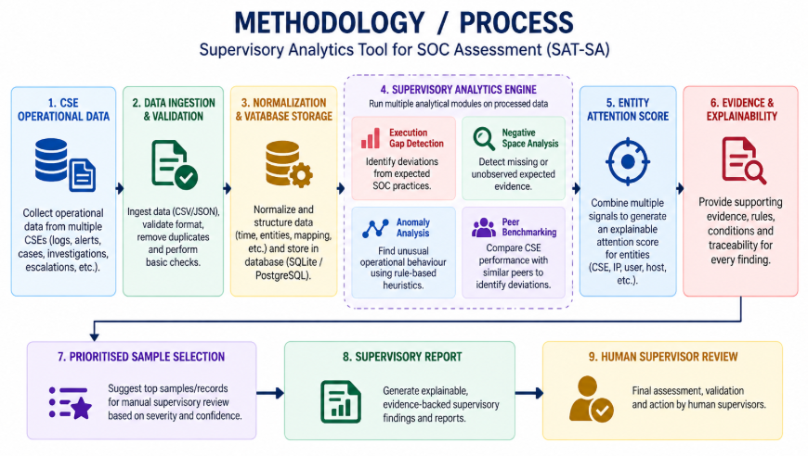
TECHNICAL APPROACH
Coder Rise
Programming Languages:
Frontend: React,Vite,CSS
Backend: Python,FastAPI
Database: SQLite,PostgreSQL
ORM: SQLAlchemy
Migration: Alembic
Data Processing & Ingestion:
CSV / JSON Data Ingestion
Data Validation & Normalization
Duplicate Handling & Batch Tracking
Structured Database Storage
Security / Supervisory Detection:
➢ Execution Gap Detection
➢ Negative Space Analysis
➢ Operational Anomaly Detection

Slide 4
FEASIBILITY AND VIABILITY
Coder
Rise
Feasibility Analysis:
Completely software-based
Working on local systems
Lightweight technology stack
Air-gapped deployment support
No external cloud or AI/API dependency
Deterministic & explainable analytics
Modular architecture for future expansion
Mitigation:
Configurable analytical rules - continuous refinement
Evidence traceability - transparent verification
Human-in-the-loop review - final assessment
Baseline & peer-data validation - before interpreting deviations
Modular architecture - add new analytics and data sources
Explicit handling of unavailable evidence - Unknown ≠ Zero
Potential Challenges:
Large volume of SOC operational data
Incomplete or missing evidence
False positives from analytical rules
Limited historical data for anomaly analysis
Insufficient peer data for benchmarking
Changing supervisory requirements

Slide 5
IMPACT AND BENEFITS
Coder
Rise
Target Users:
• SOC Assessment & Supervisory Teams
• Cybersecurity Supervisors
• Critical Sector Entities (CSEs)
• Security Governance Teams
Benefits:
Faster Evidence Triage
Better Sample Prioritisation
Evidence-backed & Traceable Findings
Improved Assessment Consistency
Operational Weakness Visibility
Multi-CSE Assessment
Controlled Deployment
Human-in-the-loop decision making
Potential Impacts:
Traditional Supervisory Assessment
Manual Sampling → Fragmented Evidence → Time-consuming Review → Difficult Prioritisation
With SAT-SA
Structured Evidence → Analytics → Prioritised Review → Evidence-backed Findings → Human Supervisory Assessment

Slide 6
RESEARCH AND REFERENCES
Coder
Rise
Researches:
Supervisory Analytics:
Evidence-based assessment
Operational pattern analysis
Multi-CSE assessment
Sample prioritisation
SOC Operational Evidence:
Alert & case analysis
Investigation & escalation records
Operational behaviour analysis
Evidence-based supervisory review
References:
NIST Cybersecurity Framework (CSF) 2.0
https://www.nist.gov/cyberframework
MITRE ATT&CK
https://attack.mitre.org/
ISO/IEC 27001
https://www.iso.org/

